Slide 1
Capturing Images
ENGR430 Computer Vision
Matthew Stein
Roger Williams University

Slide 2
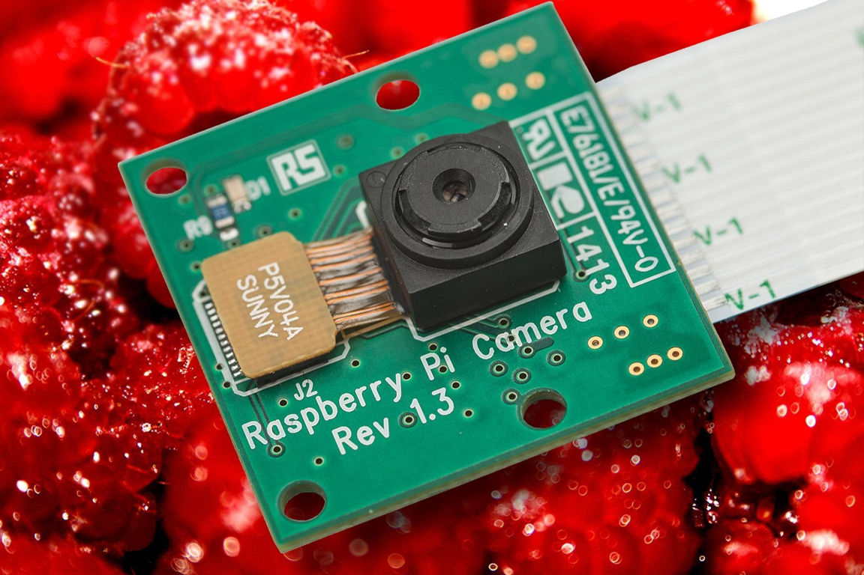

Camera
10
9
8
7
6
5
4
3
2
1

Slide 3
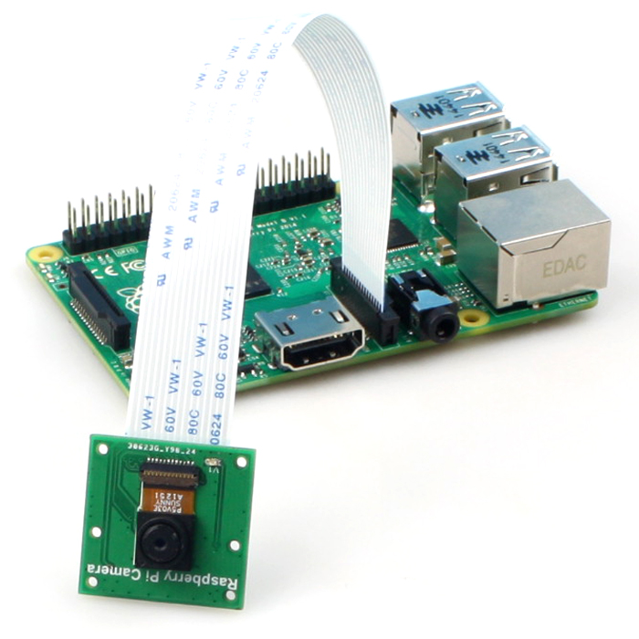
Camera Description
It attaches to Raspberry Pi by way of one of the two small sockets on the board upper surface. This interface uses the dedicated CSI interface, which was designed especially for interfacing to cameras. The CSI bus is capable of extremely high data rates, and it exclusively carries pixel data.

Slide 4
Features
5MPixel sensor with Omnivision OV5647 sensor in a fixed-focus lens
Integral IR filter
Angle of View: 54 x 41 degrees
Field of View: 2.0 x 1.33 m at 2 m
Full-frame SLR lens equivalent: 35 mm
Fixed Focus: 1 m to infinity
Still picture resolution: 2592 x 1944
Max video resolution: 1080p
Max frame rate: 30fps
Size: 25 x 24 mm
15 cm flat ribbon cable to 15-pin MIPI Camera Serial Interface (CSI) connector

Slide 5
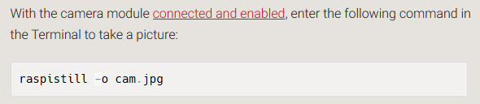
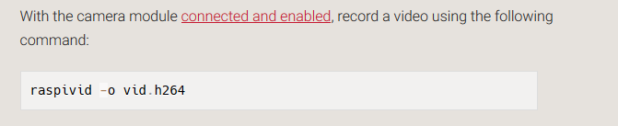
Testing from the terminal
Try these now….

Slide 6
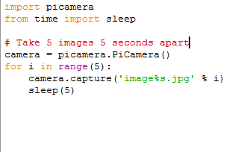
Accessing camera from python
Try this now….

Slide 7

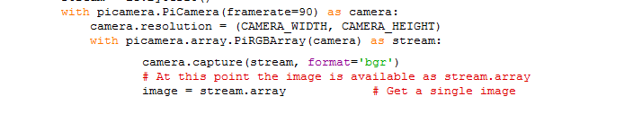
Accessing camera from python

Slide 8
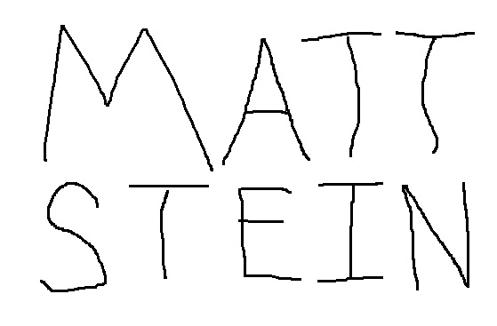
Map Construction
Create a map
Please purchase a 40x32” poster paper
Does not have to be bright white foam board but needs to not fly away with prop lift
Write you name on it an bold black sharpie

Slide 9




Map Construction
Hold the drone about 20” above the poster and capture a series of images
Transfer these images to laptop
Download autostitch64
Will attempt to reconstruct larger image, usually successful, redo if not
Name resulting image map.jpg and transfer back to Pi

